Slide 1
MINI PROJECT 1
PRESENTED BY:
ANTHONY BERNARD CERENO
KRISTINE OSEA

Slide 2
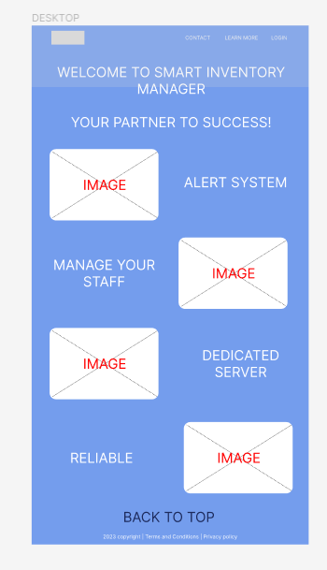
INVENTORY MANAGER
PROBLEM SOLUTION
SOLUTION
DESCRIPTION OF THE PROJECT
FEATURES AND LIMITATIONS
THEME, FONTS, LOGO, TECHNOLOGY USED
SITE MAP
MOCKUP/WIREFRAME

Slide 3
PROBLEMS
Struggle to stock shelves, or shortage sa mga paninda
Maling bilang ng mga paninda
Hirap paubusin yung mga hindi mabentang product
Nahihirapan maghanap ng supplier
Nahihirapan mamili ng mabentang brand, tulad ng kape, anung kape yung mabenta
Sobrang stocks
mga items na inaabutan na ng expiration.
list ng items na kailangan ng ipush for promotion gawa ng malapit na itong maexpire.
paano maiwasan ang kupit from employee.

Slide 4
SOLUTIONS
UPDATE REAL-TIME – TRACK INVENTORY THROUGH THE WEBSITE
ALERT SYSTEM – FOR LOW/EXPIRING ITEMS
SUGGESTION SECTION – FIND SIMILAR PRODUCTS
STAFF MANAGEMENT – ALLOW ONLY AUTHORIZED PERSONNEL
PRECISE MATHEMATICS – AUTOMATIC CALCULATION OF PRICE/OUT ITEMS
CONTACTS – RECORD/ADD SUPPLIERS FOR EASY ORDERING

Slide 5
FEATURES
Product Management
Inventory Tracking
Order Management
Reporting and Analytics
User Management

Slide 6
FEATURES AND LIMITATIONS
EASY TO NAVIGATE
RESPONSIVE DESIGN
STRAIGHT TO THE POINT
EASY TO MANAGE PEOPLE
CLICKABLE LINKS
--------------------------------------------------------------------------------------------
VIEW ONLY PAGE
NO BACK-END

Slide 7
THEME, FONTS, LOGO, TECHNOLOGY
THEME – CUSTOMIZED THEME
FONTS – SANS SERIF, VERDANA
LOGO – SELF-MADE
HTML 5
CSS 3
BOOTSTRAP

